Slide 1
Classical India
1600BCE-535CE

Slide 2
Geography
Proximity to other countries—trade—cultural diffusion (Alexander the Great/Middle East/Mediterranean countries)
What isolates India?
  Himalayas
  But even so, they found ways to be linked to other civilizations (mountain passes, sea travel, Silk Road)

Slide 3
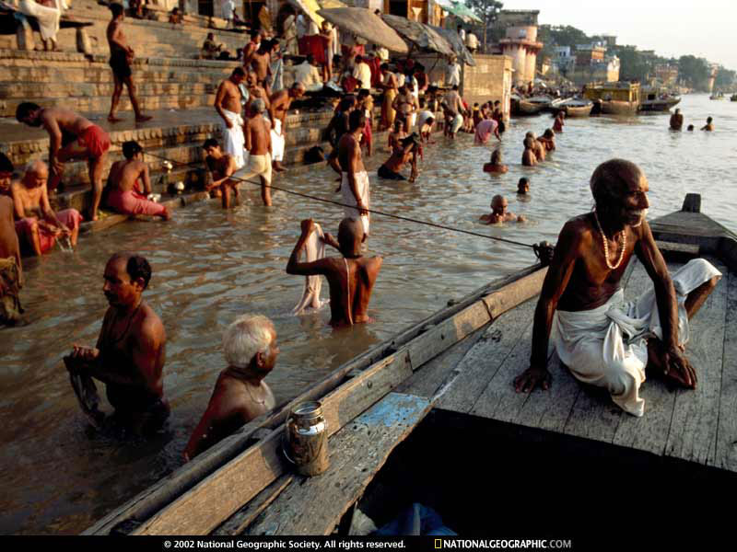
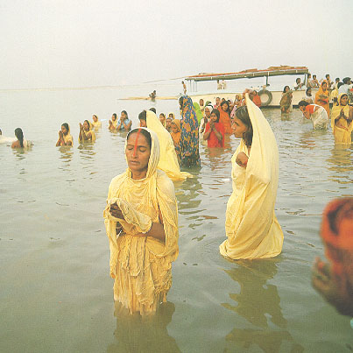
Ganges

Slide 4
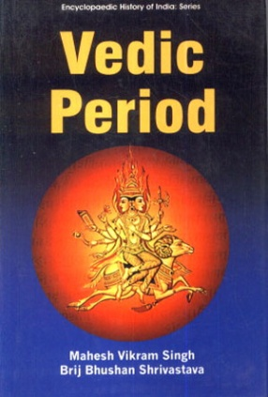
Vedic Age(Veda-knowledge)
1500-1000BCE
Pre-classical period
Vedas
  Originally oral, then written in Sanskrit
  Hymns devoted to Aryan gods
Caste system begins to take shape

Slide 5

Epic Age
1000-600BCE
Added stories to the Veda
  Mahabharata
      Greatest Epic Poem based on love, war, honor…
Upanishads
  Epic poem, mystical
Switch in caste system b/t the Brahmin and Warrior castes
  Brahmin move to the top…
    What does this indicate?

Slide 6
Aryan lifestyle
Unified villages- organized in hierarchy
Patriarchal
Caste system (during Vedic and Epic)
  To show difference b/t natives and Aryans
    Aryans were also physically different looking
      Taller, lighter skinned

Slide 7
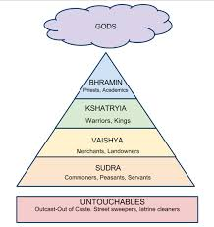
The Caste System
Kshatriyas/Brahmins-warriors/priests
Vaisyas-traders and farmers
Sudras-peasants
Pariahs-untouchables
Jati – subgroups with duties assigned
Was there social mobility?

Slide 8
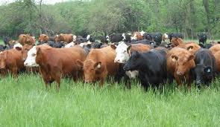
Hinduism
Derived from Indo-European gods
  That’s why similarities to Greek and other religions
Sacrifices to the gods
Sacred: cows
  Why cows?
    B/C Aryans measured their wealth by them when they first invaded the Indus River valley

Slide 9
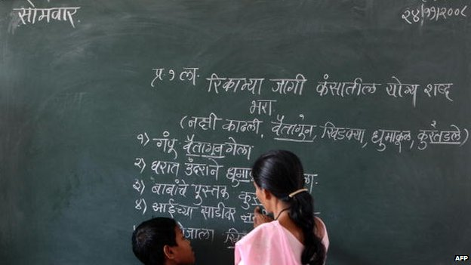
By 600 BCE…
Sanskrit was spoken by the Brahmin
Classical civilization was built upon the Vedic and Epic Ages
No dynastic cycle…but many different states with their own system of govt.

Slide 10
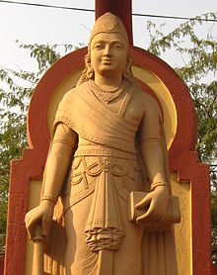
Maurya Dynasty
Chandragupta- 322BCE
  Unified most of India for the first time
  Large military with chariots
  Used elephants for war (like A the Great)
  Postal service
  Autocratic style of government
  Well guarded at all times (kind of like the President/secret service today)

Slide 11
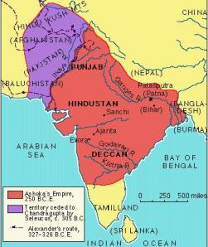

Mauryan Empire

Slide 12

Maurya (con’t.)
Ashoka
  Grandson of Chandragupta
  Began as a harsh ruler…then became Buddhist
  Sent Buddhist missionaries to M. East and Sri Lanka
    They were very interested
Expanded the empire-included all of the subcontinent except the far tip of India
Road system with ”rest areas”
  Of course trade would increase as a result
  How would you feel about a ruler like this?
Instability set in after his death…opportunity for a new Dynasty to take control

Slide 13
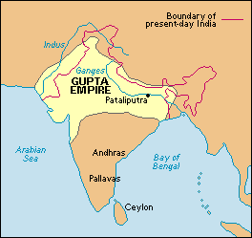
Gupta Empire (Golden Age)
320 CE
No great ruler to speak of (except Chandra Gupta)—but strong military leaders who kept the empire large (but not as large as Mauryan)
  How? They acquired territory via marriage
  marriage vs. war as a way to gain territory
    Which is better?
  535CE over run by the Huns (nomadic warriors)…these are the same Huns that sacked Rome in 476CE (that will be in the next chapter)

Slide 14
Politics
Many different types of rule depending on the ruler
Mauryan and Gupta
  Local rule was often the method of choice
  Many languages but Sanskrit was the language of the privileged
  Some uniform codes and trade routes established but generally very diverse in the method of rule and language spoken
  Patronized the arts and education

Slide 15
Indian religion did not place importance on politics
Hindu castes system essentially WAS the government…how? What did it stress?
  Also: No eating/drinking with ppl outside of your caste
What did this translate to?
  People to live with one another-peacefully

Slide 16
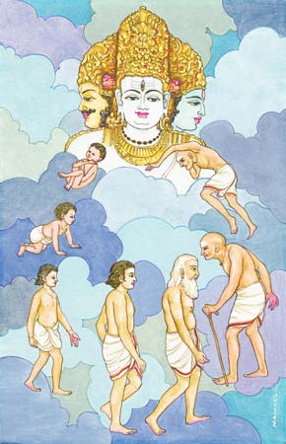
Religion/Culture
Hinduism
  Brahmin caste oversees Hinduism
  No founder
  Very adaptable/malleable –many found an aspect of it which they could relate to
  Upanishads-concerned with divine worship; not earthly concerns
  Brahmin (doctrine) and Gurus (mystics)

Slide 17
Religion Con’t.
Meditation/yoga
Reincarnation
Rituals
No beef..WHY?
Prayers and sacrifices
Dharma (moral laws-duties in life)
  Fighting in wars was OK b/c not really killing the soul, just the body…allowing them to move on and be reincarnated

Slide 18
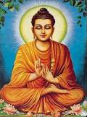
Buddhism
563BCE (birth year)
Siddhartha Gautama
  Son of a warrior
  Married…saw death and poverty
  Left his family to reach enlightenment
He rejected some Hindu beliefs (ceremonies) and the caste system
Nirvana
4 Noble Truths
8 Fold Path

Slide 19
Buddhism
It was attractive to all b/c all could achieve, regardless of caste
Lost it’s following in India, but resurfaced in China, Korea, and Japan
Other Aspects of Indian life:
Hindu Kama-sutra: text regarding “male and female relationships”

Slide 20
HINDUISM/INDIAN ACHIEVEMENTS
Panchatantra-stories that have spread around the world (Sinbad, Arabian Nights)
First University in Classical India (in Nalanda)
  Religion, philosophy, medicine, arch, ag.
Calendar, math, smallpox vaccine, sterilization
Concept of zero, negative numbers, square roots, sine, pi (pg59)
Stupas (sponsored by Ashoka):shrines to Buddha
Built roads
Art
  Sculpture, painting was less realistic under the Gupta Empire
  Very colorful

Slide 21
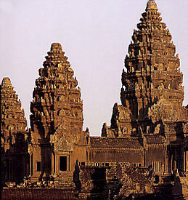
Stupas in Cambodia

Slide 22
Economy/Society
Caste System-assigned jobs
Arranged marriages…why?
Patriarchal; women had few rights
Steel trade was the best worldwide
Cotton cloth and cashmere (textiles) were also manufactured and traded
  Guilds
Merchant status?
Subsistence farming
Tamils-traders in S. India
  Who did they trade with?

Slide 23
The Indian Legacy…
A lot of trade passed by India…cultural diffusion…art, architecture, Buddhism
It’s culture has survived b/c of it’s variety to many Indians and foreign invaders.

Slide 24
China vs. India
(Differences)
Politics
Philosophy in life/politics
Isolated geographically
Centralized government
Social structure
No centralized government
Religion v philosophies
Frequent invaders (cultural diffusion)
Merchants
Openness to outsiders

Slide 25
China vs India
(Similarities)
Agriculture societies
Farmers/peasants were the majority of the population
Patriarchal
Women had little status
Trade
School/academics were important
Large cities in both

